Slide 1
NAS for Transformer with Compression
宋玉红
2020.07.18

Slide 2
Task List
The basic ideas of FTRANS
The optimization about FTRANS
NAS for transformer
BCM-based pruning using reinforcement learning

Slide 3
Task1
The basic ideas of FTRANS
Compression for transformer
Hardware acceleration design

Slide 4
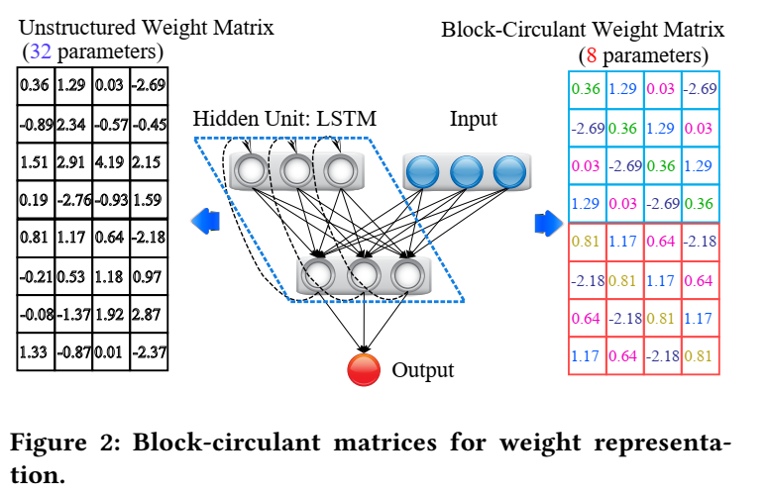
Task1
Compression for Transformer
Enhanced BCM-based compression(Block-circulant matrix)
16 fixed-point data representation for weights

Slide 5
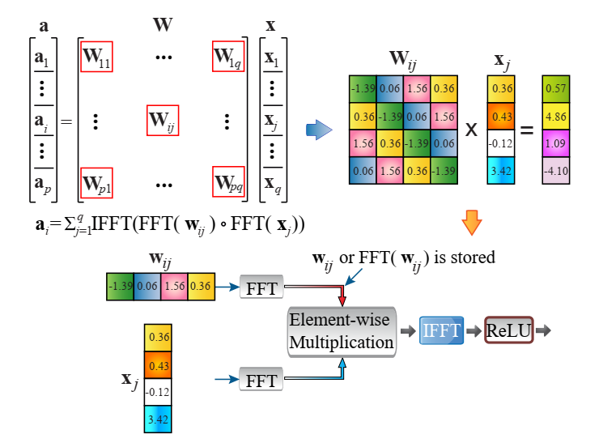
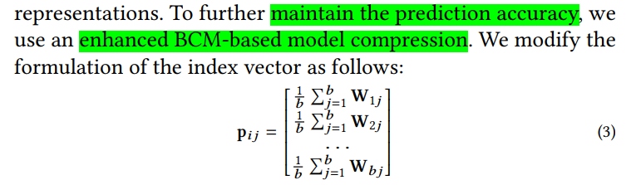
Task1
BCM
Notes:
问题：只用一行来代表一个block不是相当于把一个block内的后面的行都剪枝掉，这样准确率不是很没有保证吗？

Slide 6
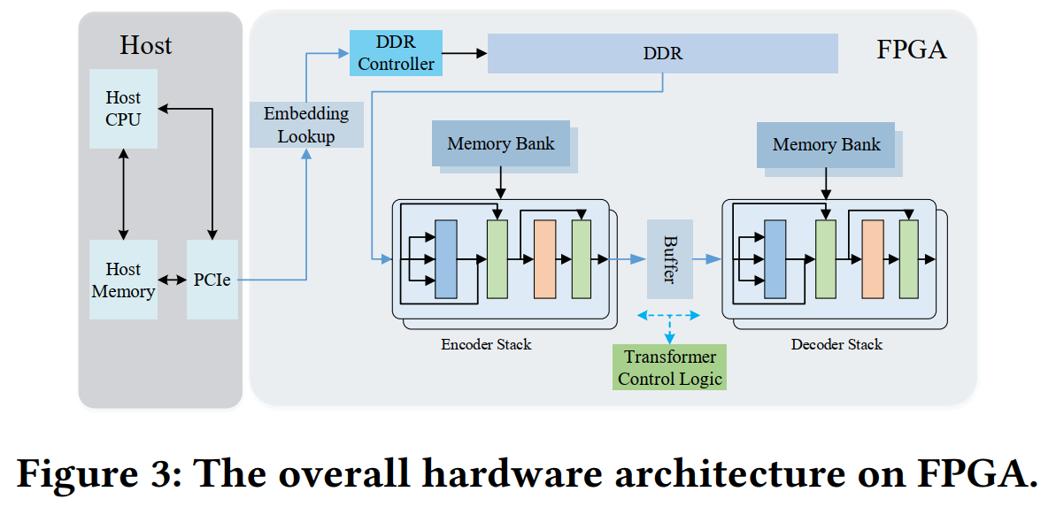
Task1
Hardware acceleration design
The overall hardware architecture
Encoder/Decoder
Transformer controller: communicate with the host and control all the modules in FPGA
On-chip memory
Off-chip controller(DDR): for token embedding
DDR controller
Notes:
Encoder和Decoder之间的粗粒度并行：
1.Encoder和Decoder之间的buffer用来作为两者并行的中间件
2.Encoder不断的读取输入的embedding，进行编码
3.将结果放入decoder，decoder就可以直接从buffer中取数据，而不需要阻塞encoder部分
4.Encoder就可以继续取下一个batch

Slide 7
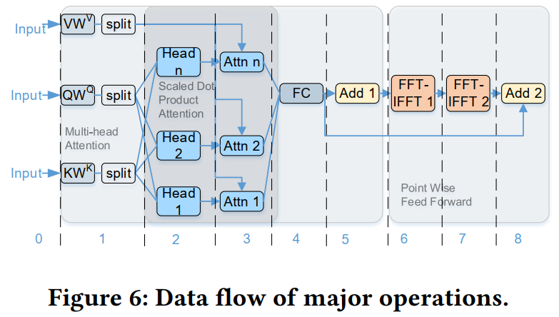
Task1
Hardware acceleration design
Data flow

Slide 8
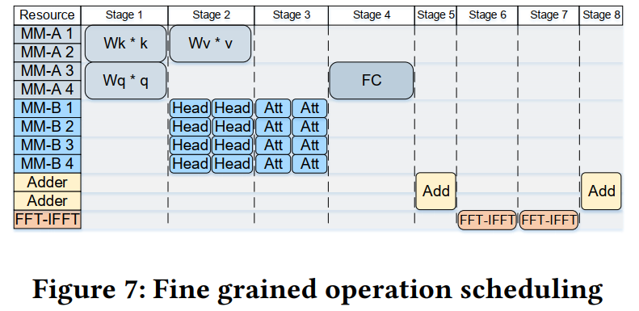
Task1
Hardware acceleration design
Fine-grained operation
Notes:
问题：1.为什么Attention层将矩阵转换成块循坏矩阵之后不使用傅里叶变换来进行矩阵乘法，上图中MM部分还是使用的矩阵乘法器来做的，只有最后的feed-forward部分的线性变换和softmax部分用的才是设计的傅里叶变换单元（文中就是这么安排的）
问题：2.为什么V的乘法单元是在stage2进行的，划分multi-head不同时做吗？
陈述：3.stage2实际上还堆叠了矩阵维度的重新缩放，和softmax操作，在stage2中使用PE进行矩阵乘法操作，内部的乘法器和除法器、指数单元之间也是并行的

Slide 9
Task2
The optimization about FTRANS
NAS for an optimal transformer architecture, using a pre-trained model
Pruning on BCM using mask
Quantization at a low-bits

Slide 10
Task3
NAS for transformer
NAS for an optimal transformer architecture
Use a pre-trained model to reduce the search time, to reach the accuracy faster
If NAS upon a pre-trained model, the search space is composed of model parameters.
If NAS from scratch, the search space includes some layer components and model parameters.
Search space
Notes:
姜师兄文章Accuracy vs. Efficiency: Achieving Both through FPGA-Implementation Aware Neural Architecture Search
在CNN上进行搜索
软件层面的搜索内容包括，layer number, filter size, channel number

Slide 11
Task3
Search space
Layer components
Attention(Decoder)
Multi-head attention layer
Normalization(yes or no)
Activation function(which)
Model parameters
Layer number(in encoder and decoder)
Head number(self-attention)
Embedding dimension(input token dimension)
Hidden dimension(output dimension through FC layer)

Slide 12
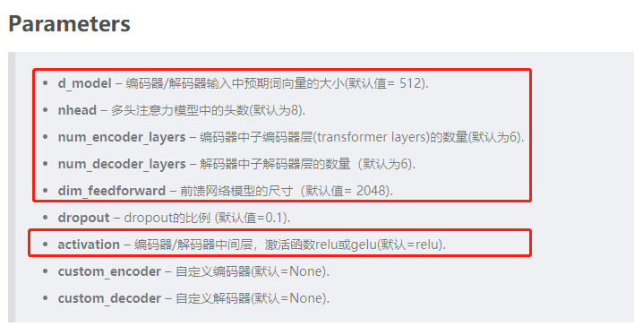
Task3
Transformer parameters in pytorch package
Notes:
dropout是指在深度学习网络的训练过程中，对于神经网络单元，按照一定的概率将其暂时从网络中丢弃。
在evolved transformer 和 lite transformer 中都涉及到了attention和convolution的结合，就是在选择该层的计算层的时候，选择attention，还是卷积（标准卷积和lightweight等）

Slide 13
Task4
BCM-based pruning using reinforcement learning
Search space
Block size
Mask
After pruning, how to compute the operation number?
Use operation number and model accuracy to co-search the best pruning method.

Slide 14
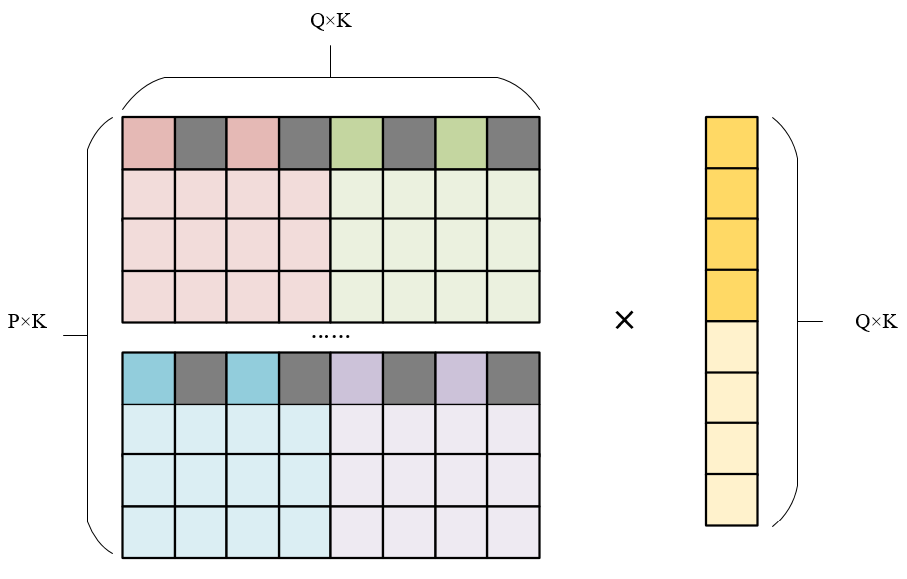
Task4
How to compute the operation number?
$Operation Number=P×$Q×K×(1-sparsity_ratio)
Notes:
每个块内深色行代表BCM保留行，灰色位置表示mask剪枝位置
矩阵乘法操作次数的计算方式： P × Q × K × 1
使用mask剪枝之后：P × Q × K × 1×（1-sparsity_ratio）

Slide 15
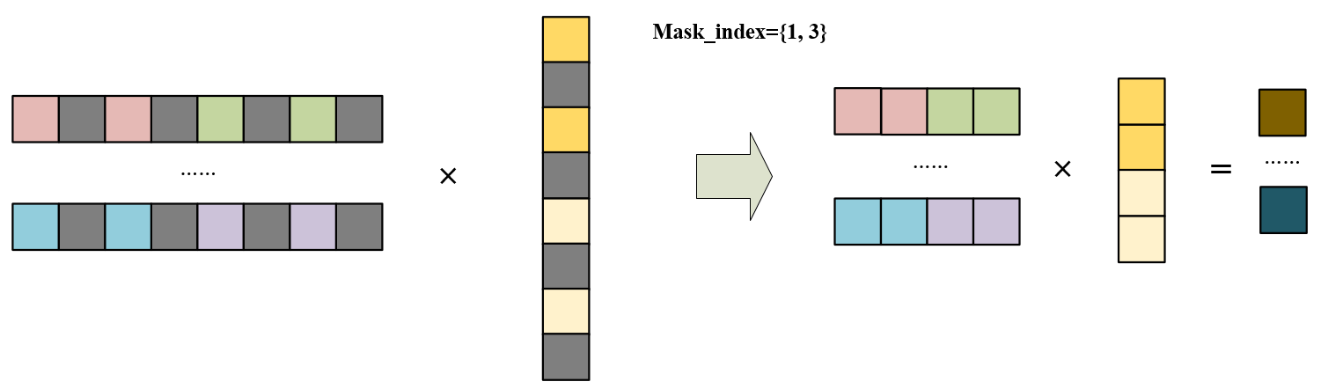
Task4
Simplify the matrix multiplication
$Storage Number=(P×$ Q ×K+Q×K×1)×(1-sparsity_ratio)
Notes:
最初矩阵的存储数量=P×K×Q×K + Q×K×1
使用快循环矩阵之后存储数量=P×Q×K + Q×K×1
加mask之后矩阵的存储数量=$（P×$Q×K+Q×K×1）×(1-sparsity_ratio)

